Slide 1

Resolução do problema teórico 1 (T1)

Slide 2
Resolução do problema teórico 1 (T1)
54 ouros
68 pratas
93 bronzes
1 ouro e 4 bronzes pro Brasil
Primeiro ouro do Brasil

Slide 3
T1 IPhO 2011
1.1

Slide 4
T1 IPhO 2011
1.1
Centro de massa:

Slide 5

T1 IPhO 2011
1.1
Centro de massa:
$$mr=MR$$

Slide 6
T1 IPhO 2011
1.1
Centro de massa:
$$mr=MR$$
Forças:

Slide 7
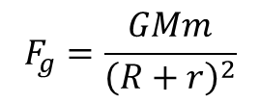

T1 IPhO 2011
1.1
Centro de massa:
$$mr=MR$$
Forças:
$$F_{g}=\frac{GMm}{{\left(R+r\right)}^{2}}$$
$$F_{c}=mω_{0}^{2}r$$

Slide 8

T1 IPhO 2011
1.1
Centro de massa:
$$mr=MR$$
Forças:
$$F_{g}=\frac{GMm}{{\left(R+r\right)}^{2}}$$
$$F_{c}=mω_{0}^{2}r$$
Dinâmica:
$$F_{g}=F_{c}$$

Slide 9

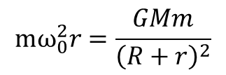
T1 IPhO 2011
1.1
Centro de massa:
$$mr=MR$$
Forças:
$$F_{g}=\frac{GMm}{{\left(R+r\right)}^{2}}$$
$$F_{c}=mω_{0}^{2}r$$
Dinâmica:
$$mω_{0}^{2}r=\frac{GMm}{{\left(R+r\right)}^{2}}$$
$$F_{g}=F_{c}$$
$$→$$

Slide 10

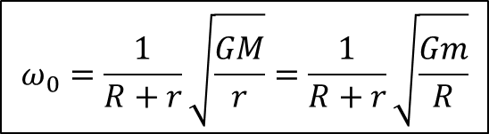
T1 IPhO 2011
1.1
Centro de massa:
$$mr=MR$$
Forças:
$$F_{g}=\frac{GMm}{{\left(R+r\right)}^{2}}$$
$$F_{c}=mω_{0}^{2}r$$
Dinâmica:
$$ω_{0}=\frac{1}{R+r}\sqrt{\frac{GM}{r}}=\frac{1}{R+r}\sqrt{\frac{Gm}{R}}$$
$$mω_{0}^{2}r=\frac{GMm}{{\left(R+r\right)}^{2}}$$
$$F_{g}=F_{c}$$
$$→$$
$$→$$

Slide 11
T1 IPhO 2011
1.2

Slide 12
T1 IPhO 2011
1.2
Notação vetorial:

Slide 13
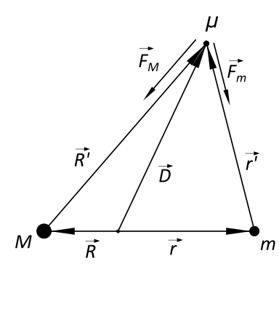
T1 IPhO 2011
1.2
Notação vetorial:

Slide 14
T1 IPhO 2011
1.2
Vetores:

Slide 15

T1 IPhO 2011
1.2
Vetores:
$$\vec{D}=\vec{R}+\vec{R′}=\vec{r}+\vec{r′}$$

Slide 16
T1 IPhO 2011
1.2
Vetores:
$$\vec{D}=\vec{R}+\vec{R′}=\vec{r}+\vec{r′}$$
Forças:

Slide 17
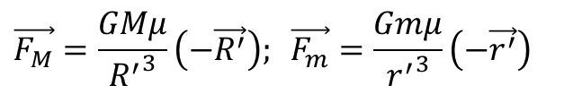
T1 IPhO 2011
1.2
Vetores:
$$\vec{D}=\vec{R}+\vec{R′}=\vec{r}+\vec{r′}$$
Forças:
$$\vec{F_{M}}=\frac{GMμ}{{R^{′}}^{3}}\left(−\vec{R^{′}}\right); \vec{F_{m}}=\frac{Gmμ}{{r^{′}}^{3}}\left(−\vec{r^{′}}\right)$$

Slide 18
T1 IPhO 2011
1.2
Vetores:
$$\vec{D}=\vec{R}+\vec{R′}=\vec{r}+\vec{r′}$$
Forças:
$$\vec{F_{M}}=\frac{GMμ}{{R^{′}}^{3}}\left(−\vec{R^{′}}\right); \vec{F_{m}}=\frac{Gmμ}{{r^{′}}^{3}}\left(−\vec{r^{′}}\right)$$
Dinâmica:

Slide 19
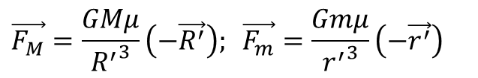

T1 IPhO 2011
1.2
Vetores:
$$\vec{D}=\vec{R}+\vec{R′}=\vec{r}+\vec{r′}$$
Forças:
$$\vec{F_{M}}=\frac{GMμ}{{R^{′}}^{3}}\left(−\vec{R^{′}}\right); \vec{F_{m}}=\frac{Gmμ}{{r^{′}}^{3}}\left(−\vec{r^{′}}\right)$$
Dinâmica:
$$\vec{F_{M}}+\vec{F_{m}}=μω_{0}^{2}(−\vec{D})$$

Slide 20
T1 IPhO 2011
1.2
Vetores:
$$\vec{D}=\vec{R}+\vec{R′}=\vec{r}+\vec{r′}$$
Forças:
$$\vec{F_{M}}=\frac{GMμ}{{R^{′}}^{3}}\left(−\vec{R^{′}}\right); \vec{F_{m}}=\frac{Gmμ}{{r^{′}}^{3}}\left(−\vec{r^{′}}\right)$$
Dinâmica:
$$\vec{F_{M}}+\vec{F_{m}}=μω_{0}^{2}(−\vec{D})$$
Centro de massa:

Slide 21

T1 IPhO 2011
1.2
Vetores:
$$\vec{D}=\vec{R}+\vec{R′}=\vec{r}+\vec{r′}$$
Forças:
$$\vec{F_{M}}=\frac{GMμ}{{R^{′}}^{3}}\left(−\vec{R^{′}}\right); \vec{F_{m}}=\frac{Gmμ}{{r^{′}}^{3}}\left(−\vec{r^{′}}\right)$$
Dinâmica:
$$\vec{F_{M}}+\vec{F_{m}}=μω_{0}^{2}(−\vec{D})$$
Centro de massa:
$$M\vec{R}+m\vec{r}=0$$

Slide 22
T1 IPhO 2011
1.2
Contas:

Slide 23
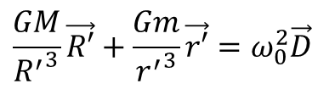
T1 IPhO 2011
1.2
Contas:
$$\frac{GM}{{R^{′}}^{3}}\vec{R′}+\frac{Gm}{{r^{′}}^{3}}\vec{r′}=ω_{0}^{2}\vec{D}$$

Slide 24
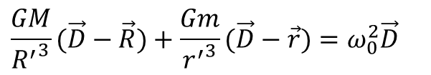
T1 IPhO 2011
1.2
Contas:
$$\frac{GM}{{R^{′}}^{3}}\vec{R′}+\frac{Gm}{{r^{′}}^{3}}\vec{r′}=ω_{0}^{2}\vec{D}$$
$$\frac{GM}{{R^{′}}^{3}}(\vec{D}−\vec{R})+\frac{Gm}{{r^{′}}^{3}}(\vec{D}−\vec{r})=ω_{0}^{2}\vec{D}$$

Slide 25
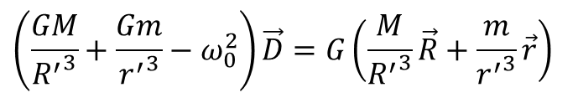
T1 IPhO 2011
1.2
Contas:
$$\frac{GM}{{R^{′}}^{3}}\vec{R′}+\frac{Gm}{{r^{′}}^{3}}\vec{r′}=ω_{0}^{2}\vec{D}$$
$$\frac{GM}{{R^{′}}^{3}}(\vec{D}−\vec{R})+\frac{Gm}{{r^{′}}^{3}}(\vec{D}−\vec{r})=ω_{0}^{2}\vec{D}$$
$$\left(\frac{GM}{{R^{′}}^{3}}+\frac{Gm}{{r^{′}}^{3}}−ω_{0}^{2}\right)\vec{D}=G\left(\frac{M}{{R^{′}}^{3}}\vec{R}+\frac{m}{{r^{′}}^{3}}\vec{r}\right)$$

Slide 26
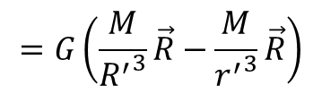
T1 IPhO 2011
1.2
Contas:
$$\frac{GM}{{R^{′}}^{3}}\vec{R′}+\frac{Gm}{{r^{′}}^{3}}\vec{r′}=ω_{0}^{2}\vec{D}$$
$$\frac{GM}{{R^{′}}^{3}}(\vec{D}−\vec{R})+\frac{Gm}{{r^{′}}^{3}}(\vec{D}−\vec{r})=ω_{0}^{2}\vec{D}$$
$$\left(\frac{GM}{{R^{′}}^{3}}+\frac{Gm}{{r^{′}}^{3}}−ω_{0}^{2}\right)\vec{D}=G\left(\frac{M}{{R^{′}}^{3}}\vec{R}+\frac{m}{{r^{′}}^{3}}\vec{r}\right)$$
$$=G\left(\frac{M}{{R^{′}}^{3}}\vec{R}−\frac{M}{{r^{′}}^{3}}\vec{R}\right)$$

Slide 27
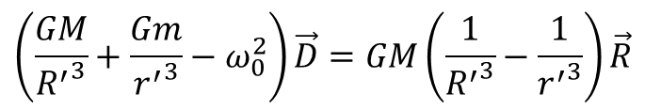
T1 IPhO 2011
1.2
Contas:
$$\frac{GM}{{R^{′}}^{3}}\vec{R′}+\frac{Gm}{{r^{′}}^{3}}\vec{r′}=ω_{0}^{2}\vec{D}$$
$$\frac{GM}{{R^{′}}^{3}}(\vec{D}−\vec{R})+\frac{Gm}{{r^{′}}^{3}}(\vec{D}−\vec{r})=ω_{0}^{2}\vec{D}$$
$$\left(\frac{GM}{{R^{′}}^{3}}+\frac{Gm}{{r^{′}}^{3}}−ω_{0}^{2}\right)\vec{D}=G\left(\frac{M}{{R^{′}}^{3}}\vec{R}+\frac{m}{{r^{′}}^{3}}\vec{r}\right)$$
$$=G\left(\frac{M}{{R^{′}}^{3}}\vec{R}−\frac{M}{{r^{′}}^{3}}\vec{R}\right)$$
$$\left(\frac{GM}{{R^{′}}^{3}}+\frac{Gm}{{r^{′}}^{3}}−ω_{0}^{2}\right)\vec{D}=GM\left(\frac{1}{{R^{′}}^{3}}−\frac{1}{{r^{′}}^{3}}\right)\vec{R}$$

Slide 28

T1 IPhO 2011
1.2
$\vec{D}$ não é colinear nem com $\vec{R}$ e nem com $\vec{r}$:

Slide 29
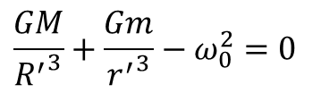
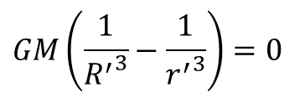
T1 IPhO 2011
1.2
$\vec{D}$ não é colinear nem com $\vec{R}$ e nem com $\vec{r}$:
$$\frac{GM}{{R^{′}}^{3}}+\frac{Gm}{{r^{′}}^{3}}−ω_{0}^{2}=0$$
$$GM\left(\frac{1}{{R^{′}}^{3}}−\frac{1}{{r^{′}}^{3}}\right)=0$$

Slide 30
T1 IPhO 2011
1.2
$\vec{D}$ não é colinear nem com $\vec{R}$ e nem com $\vec{r}$:
$$\frac{GM}{{R^{′}}^{3}}+\frac{Gm}{{r^{′}}^{3}}−ω_{0}^{2}=0$$
$$GM\left(\frac{1}{{R^{′}}^{3}}−\frac{1}{{r^{′}}^{3}}\right)=0$$
Daí:

Slide 31

T1 IPhO 2011
1.2
$\vec{D}$ não é colinear nem com $\vec{R}$ e nem com $\vec{r}$:
$$\frac{GM}{{R^{′}}^{3}}+\frac{Gm}{{r^{′}}^{3}}−ω_{0}^{2}=0$$
$$GM\left(\frac{1}{{R^{′}}^{3}}−\frac{1}{{r^{′}}^{3}}\right)=0$$
Daí:
$$R^{′}=r′$$

Slide 32
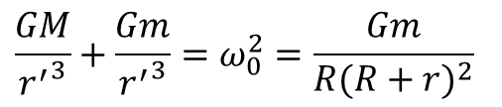
T1 IPhO 2011
1.2
$\vec{D}$ não é colinear nem com $\vec{R}$ e nem com $\vec{r}$:
$$\frac{GM}{{R^{′}}^{3}}+\frac{Gm}{{r^{′}}^{3}}−ω_{0}^{2}=0$$
$$GM\left(\frac{1}{{R^{′}}^{3}}−\frac{1}{{r^{′}}^{3}}\right)=0$$
Daí:
$$R^{′}=r′$$
$$\frac{GM}{{r^{′}}^{3}}+\frac{Gm}{{r^{′}}^{3}}=ω_{0}^{2}=\frac{Gm}{R{(R+r)}^{2}}$$

Slide 33
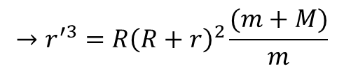
T1 IPhO 2011
1.2
$\vec{D}$ não é colinear nem com $\vec{R}$ e nem com $\vec{r}$:
$$\frac{GM}{{R^{′}}^{3}}+\frac{Gm}{{r^{′}}^{3}}−ω_{0}^{2}=0$$
$$GM\left(\frac{1}{{R^{′}}^{3}}−\frac{1}{{r^{′}}^{3}}\right)=0$$
Daí:
$$R^{′}=r′$$
$$\frac{GM}{{r^{′}}^{3}}+\frac{Gm}{{r^{′}}^{3}}=ω_{0}^{2}=\frac{Gm}{R{(R+r)}^{2}}$$
$$→r^{′3}=R{\left(R+r\right)}^{2}\frac{(m+M)}{m}$$

Slide 34
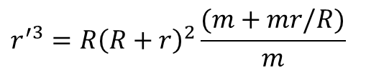
T1 IPhO 2011
1.2
$\vec{D}$ não é colinear nem com $\vec{R}$ e nem com $\vec{r}$:
$$\frac{GM}{{R^{′}}^{3}}+\frac{Gm}{{r^{′}}^{3}}−ω_{0}^{2}=0$$
$$GM\left(\frac{1}{{R^{′}}^{3}}−\frac{1}{{r^{′}}^{3}}\right)=0$$
Daí:
$$R^{′}=r′$$
$$\frac{GM}{{r^{′}}^{3}}+\frac{Gm}{{r^{′}}^{3}}=ω_{0}^{2}=\frac{Gm}{R{(R+r)}^{2}}$$
$$→r^{′3}=R{\left(R+r\right)}^{2}\frac{(m+M)}{m}$$
$$r^{′3}=R{\left(R+r\right)}^{2}\frac{(m+mr/R)}{m}$$

Slide 35

T1 IPhO 2011
1.2
$\vec{D}$ não é colinear nem com $\vec{R}$ e nem com $\vec{r}$:
$$\frac{GM}{{R^{′}}^{3}}+\frac{Gm}{{r^{′}}^{3}}−ω_{0}^{2}=0$$
$$GM\left(\frac{1}{{R^{′}}^{3}}−\frac{1}{{r^{′}}^{3}}\right)=0$$
Daí:
$$R^{′}=r′$$
$$\frac{GM}{{r^{′}}^{3}}+\frac{Gm}{{r^{′}}^{3}}=ω_{0}^{2}=\frac{Gm}{R{(R+r)}^{2}}$$
$$→r^{′3}=R{\left(R+r\right)}^{2}\frac{(m+M)}{m}$$
$$r^{′3}=R{\left(R+r\right)}^{2}\frac{(m+mr/R)}{m}$$
$${=\left(R+r\right)}^{3}$$

Slide 36


T1 IPhO 2011
1.2
$\vec{D}$ não é colinear nem com $\vec{R}$ e nem com $\vec{r}$:
$$\frac{GM}{{R^{′}}^{3}}+\frac{Gm}{{r^{′}}^{3}}−ω_{0}^{2}=0$$
$$GM\left(\frac{1}{{R^{′}}^{3}}−\frac{1}{{r^{′}}^{3}}\right)=0$$
Daí:
$$R^{′}=r′$$
$$\frac{GM}{{r^{′}}^{3}}+\frac{Gm}{{r^{′}}^{3}}=ω_{0}^{2}=\frac{Gm}{R{(R+r)}^{2}}$$
$$→r^{′3}=R{\left(R+r\right)}^{2}\frac{(m+M)}{m}$$
$$r^{′3}=R{\left(R+r\right)}^{2}\frac{(m+mr/R)}{m}$$
$${=\left(R+r\right)}^{3}$$
$$→$$
$$r^{′}=R^{′}=r+R$$

Slide 37
T1 IPhO 2011
1.2
Para achar D:

Slide 38
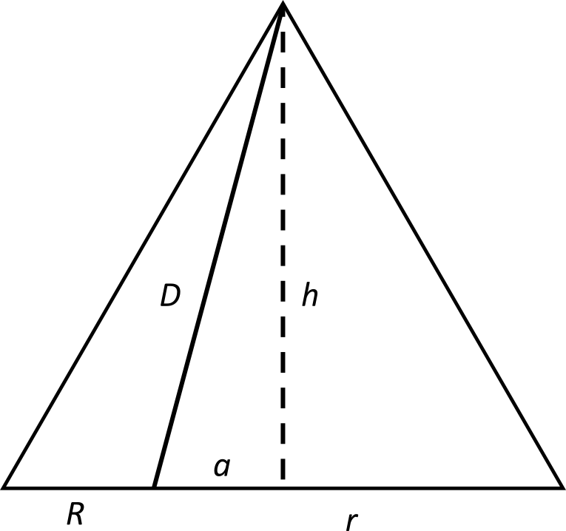
T1 IPhO 2011
1.2
Para achar D:

Slide 39

T1 IPhO 2011
1.2
Para achar D:
$$a=\frac{R+r}{2}−R$$

Slide 40

T1 IPhO 2011
1.2
Para achar D:
$$a=\frac{R+r}{2}−R$$
$$=\frac{r−R}{2}$$

Slide 41

T1 IPhO 2011
1.2
Para achar D:
$$a=\frac{R+r}{2}−R$$
$$=\frac{r−R}{2}$$
$$h^{2}=D^{2}−a^{2}$$

Slide 42

T1 IPhO 2011
1.2
Para achar D:
$$a=\frac{R+r}{2}−R$$
$$=\frac{r−R}{2}$$
$$h^{2}=D^{2}−a^{2}$$
$${=\left(r+R\right)}^{2}−{\left(r+R\right)}^{2}/4$$

Slide 43
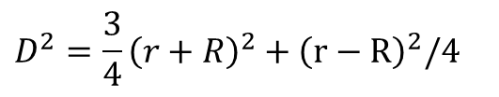
T1 IPhO 2011
1.2
Para achar D:
$$a=\frac{R+r}{2}−R$$
$$=\frac{r−R}{2}$$
$$h^{2}=D^{2}−a^{2}$$
$${=\left(r+R\right)}^{2}−{\left(r+R\right)}^{2}/4$$
$$D^{2}=\frac{3}{4}{\left(r+R\right)}^{2}+{\left(r−R\right)}^{2}/4$$

Slide 44

T1 IPhO 2011
1.2
Para achar D:
$$a=\frac{R+r}{2}−R$$
$$=\frac{r−R}{2}$$
$$h^{2}=D^{2}−a^{2}$$
$${=\left(r+R\right)}^{2}−{\left(r+R\right)}^{2}/4$$
$$D^{2}=\frac{3}{4}{\left(r+R\right)}^{2}+{\left(r−R\right)}^{2}/4$$
$$D=\sqrt{r^{2}+R^{2}+rR}$$

Slide 45
T1 IPhO 2011
1.3

Slide 46
T1 IPhO 2011
1.3
Desenho esquemático:

Slide 47
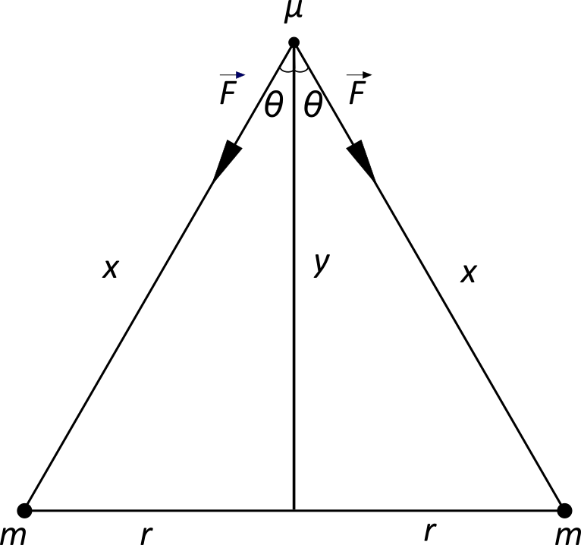
T1 IPhO 2011
1.3
Desenho esquemático:

Slide 48

T1 IPhO 2011
1.3
Desenho esquemático:
$$x=\sqrt{r^{2}+y^{2}}$$

Slide 49

T1 IPhO 2011
1.3
Desenho esquemático:
$$x=\sqrt{r^{2}+y^{2}}$$
$$\cos{θ=\frac{y}{x}}$$

Slide 50

T1 IPhO 2011
1.3
Desenho esquemático:
$$x=\sqrt{r^{2}+y^{2}}$$
$$\cos{θ=\frac{y}{x}}$$
$$D=\sqrt{r^{2}+r^{2}+r^{2}}=\sqrt{3}r$$

Slide 51
T1 IPhO 2011
1.3
Forças:

Slide 52
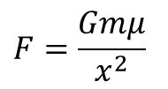
T1 IPhO 2011
1.3
Forças:
$$F=\frac{Gmμ}{x^{2}}$$

Slide 53
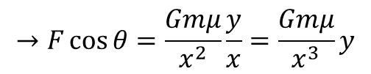
T1 IPhO 2011
1.3
Forças:
$$F=\frac{Gmμ}{x^{2}}$$
$$→F\cos{θ}=\frac{Gmμ}{x^{2}}\frac{y}{x}=\frac{Gmμ}{x^{3}}y$$

Slide 54
T1 IPhO 2011
1.3
Forças:
$$F=\frac{Gmμ}{x^{2}}$$
$$→F\cos{θ}=\frac{Gmμ}{x^{2}}\frac{y}{x}=\frac{Gmμ}{x^{3}}y$$
Conservação do momento angular:

Slide 55

T1 IPhO 2011
1.3
Forças:
$$F=\frac{Gmμ}{x^{2}}$$
$$→F\cos{θ}=\frac{Gmμ}{x^{2}}\frac{y}{x}=\frac{Gmμ}{x^{3}}y$$
Conservação do momento angular:
$$μy^{2}ω=μD^{2}ω_{0}$$

Slide 56
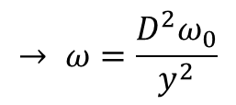
T1 IPhO 2011
1.3
Forças:
$$F=\frac{Gmμ}{x^{2}}$$
$$→F\cos{θ}=\frac{Gmμ}{x^{2}}\frac{y}{x}=\frac{Gmμ}{x^{3}}y$$
Conservação do momento angular:
$$→ ω=\frac{D^{2}ω_{0}}{y^{2}}$$
$$μy^{2}ω=μD^{2}ω_{0}$$

Slide 57
T1 IPhO 2011
1.3
Forças:
$$F=\frac{Gmμ}{x^{2}}$$
$$→F\cos{θ}=\frac{Gmμ}{x^{2}}\frac{y}{x}=\frac{Gmμ}{x^{3}}y$$
Conservação do momento angular:
$$→ ω=\frac{D^{2}ω_{0}}{y^{2}}$$
$$μy^{2}ω=μD^{2}ω_{0}$$
Pequenas oscilações:

Slide 58

T1 IPhO 2011
1.3
Forças:
$$F=\frac{Gmμ}{x^{2}}$$
$$→F\cos{θ}=\frac{Gmμ}{x^{2}}\frac{y}{x}=\frac{Gmμ}{x^{3}}y$$
Conservação do momento angular:
$$→ ω=\frac{D^{2}ω_{0}}{y^{2}}$$
$$μy^{2}ω=μD^{2}ω_{0}$$
Pequenas oscilações:
$$y=D+ε;\left|ε\right|≪D$$

Slide 59
T1 IPhO 2011
1.3
Forças:
$$F=\frac{Gmμ}{x^{2}}$$
$$→F\cos{θ}=\frac{Gmμ}{x^{2}}\frac{y}{x}=\frac{Gmμ}{x^{3}}y$$
Conservação do momento angular:
$$→ ω=\frac{D^{2}ω_{0}}{y^{2}}$$
$$μy^{2}ω=μD^{2}ω_{0}$$
Pequenas oscilações:
$$y=D+ε;\left|ε\right|≪D$$
2ª Lei de Newton:

Slide 60

T1 IPhO 2011
1.3
Forças:
$$F=\frac{Gmμ}{x^{2}}$$
$$→F\cos{θ}=\frac{Gmμ}{x^{2}}\frac{y}{x}=\frac{Gmμ}{x^{3}}y$$
Conservação do momento angular:
$$→ ω=\frac{D^{2}ω_{0}}{y^{2}}$$
$$μy^{2}ω=μD^{2}ω_{0}$$
Pequenas oscilações:
$$y=D+ε;\left|ε\right|≪D$$
2ª Lei de Newton:
$$−2F\cos{θ}=μ\left(\ddot{y}−yω^{2}\right)$$

Slide 61
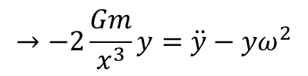
T1 IPhO 2011
1.3
Forças:
$$F=\frac{Gmμ}{x^{2}}$$
$$→F\cos{θ}=\frac{Gmμ}{x^{2}}\frac{y}{x}=\frac{Gmμ}{x^{3}}y$$
Conservação do momento angular:
$$→ ω=\frac{D^{2}ω_{0}}{y^{2}}$$
$$μy^{2}ω=μD^{2}ω_{0}$$
Pequenas oscilações:
$$y=D+ε;\left|ε\right|≪D$$
2ª Lei de Newton:
$$→−2\frac{Gm}{x^{3}}y=\ddot{y}−yω^{2}$$
$$−2F\cos{θ}=μ\left(\ddot{y}−yω^{2}\right)$$

Slide 62
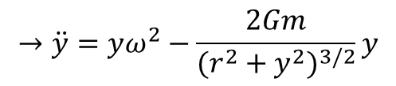
T1 IPhO 2011
1.3
Forças:
$$F=\frac{Gmμ}{x^{2}}$$
$$→F\cos{θ}=\frac{Gmμ}{x^{2}}\frac{y}{x}=\frac{Gmμ}{x^{3}}y$$
Conservação do momento angular:
$$→ ω=\frac{D^{2}ω_{0}}{y^{2}}$$
$$μy^{2}ω=μD^{2}ω_{0}$$
Pequenas oscilações:
$$y=D+ε;\left|ε\right|≪D$$
2ª Lei de Newton:
$$→−2\frac{Gm}{x^{3}}y=\ddot{y}−yω^{2}$$
$$→\ddot{y}=yω^{2}−\frac{2Gm}{{(r^{2}+y^{2})}^{3/2}}y$$
$$−2F\cos{θ}=μ\left(\ddot{y}−yω^{2}\right)$$

Slide 63
T1 IPhO 2011
1.3
Contas:

Slide 64
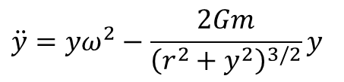
T1 IPhO 2011
1.3
Contas:
$$\ddot{y}=yω^{2}−\frac{2Gm}{{\left(r^{2}+y^{2}\right)}^{3/2}}y$$

Slide 65
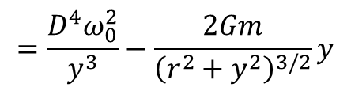
T1 IPhO 2011
1.3
Contas:
$$\ddot{y}=yω^{2}−\frac{2Gm}{{\left(r^{2}+y^{2}\right)}^{3/2}}y$$
$$=\frac{D^{4}ω_{0}^{2}}{y^{3}}−\frac{2Gm}{{\left(r^{2}+y^{2}\right)}^{3/2}}y$$

Slide 66
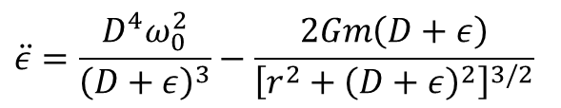
T1 IPhO 2011
1.3
Contas:
$$\ddot{y}=yω^{2}−\frac{2Gm}{{\left(r^{2}+y^{2}\right)}^{3/2}}y$$
$$=\frac{D^{4}ω_{0}^{2}}{y^{3}}−\frac{2Gm}{{\left(r^{2}+y^{2}\right)}^{3/2}}y$$
$$\ddot{ε}=\frac{D^{4}ω_{0}^{2}}{{\left(D+ε\right)}^{3}}−\frac{2Gm\left(D+ε\right)}{{\left[r^{2}+{\left(D+ε\right)}^{2}\right]}^{3/2}}$$

Slide 67
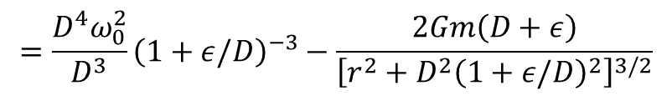
T1 IPhO 2011
1.3
Contas:
$$\ddot{y}=yω^{2}−\frac{2Gm}{{\left(r^{2}+y^{2}\right)}^{3/2}}y$$
$$=\frac{D^{4}ω_{0}^{2}}{y^{3}}−\frac{2Gm}{{\left(r^{2}+y^{2}\right)}^{3/2}}y$$
$$\ddot{ε}=\frac{D^{4}ω_{0}^{2}}{{\left(D+ε\right)}^{3}}−\frac{2Gm\left(D+ε\right)}{{\left[r^{2}+{\left(D+ε\right)}^{2}\right]}^{3/2}}$$
$$=\frac{D^{4}ω_{0}^{2}}{D^{3}}{\left(1+ε/D\right)}^{−3}−\frac{2Gm\left(D+ε\right)}{{\left[r^{2}+{D^{2}\left(1+ε/D\right)}^{2}\right]}^{3/2}}$$

Slide 68
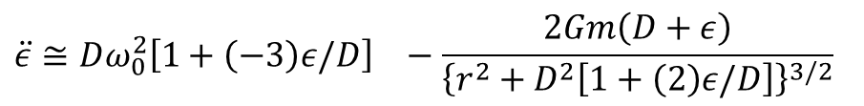
T1 IPhO 2011
1.3
Contas:
$$\ddot{y}=yω^{2}−\frac{2Gm}{{\left(r^{2}+y^{2}\right)}^{3/2}}y$$
$$=\frac{D^{4}ω_{0}^{2}}{y^{3}}−\frac{2Gm}{{\left(r^{2}+y^{2}\right)}^{3/2}}y$$
$$\ddot{ε}=\frac{D^{4}ω_{0}^{2}}{{\left(D+ε\right)}^{3}}−\frac{2Gm\left(D+ε\right)}{{\left[r^{2}+{\left(D+ε\right)}^{2}\right]}^{3/2}}$$
$$=\frac{D^{4}ω_{0}^{2}}{D^{3}}{\left(1+ε/D\right)}^{−3}−\frac{2Gm\left(D+ε\right)}{{\left[r^{2}+{D^{2}\left(1+ε/D\right)}^{2}\right]}^{3/2}}$$
$$\ddot{ε}≅Dω_{0}^{2}{\left[1+\left(−3\right)ε/D\right]}^{}−\frac{2Gm\left(D+ε\right)}{{\left\{r^{2}+D^{2}\left[1+\left(2\right)ε/D\right]\right\}}^{3/2}}$$

Slide 69
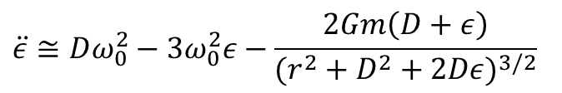
T1 IPhO 2011
1.3
Contas:
$$\ddot{y}=yω^{2}−\frac{2Gm}{{\left(r^{2}+y^{2}\right)}^{3/2}}y$$
$$=\frac{D^{4}ω_{0}^{2}}{y^{3}}−\frac{2Gm}{{\left(r^{2}+y^{2}\right)}^{3/2}}y$$
$$\ddot{ε}=\frac{D^{4}ω_{0}^{2}}{{\left(D+ε\right)}^{3}}−\frac{2Gm\left(D+ε\right)}{{\left[r^{2}+{\left(D+ε\right)}^{2}\right]}^{3/2}}$$
$$=\frac{D^{4}ω_{0}^{2}}{D^{3}}{\left(1+ε/D\right)}^{−3}−\frac{2Gm\left(D+ε\right)}{{\left[r^{2}+{D^{2}\left(1+ε/D\right)}^{2}\right]}^{3/2}}$$
$$\ddot{ε}≅Dω_{0}^{2}{\left[1+\left(−3\right)ε/D\right]}^{}−\frac{2Gm\left(D+ε\right)}{{\left\{r^{2}+D^{2}\left[1+\left(2\right)ε/D\right]\right\}}^{3/2}}$$
$$\ddot{ε}≅Dω_{0}^{2}−3ω_{0}^{2}ε−\frac{2Gm\left(D+ε\right)}{{(r^{2}+D^{2}+2Dε)}^{3/2}}$$

Slide 70
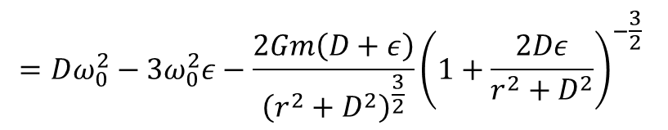
T1 IPhO 2011
1.3
Contas:
$$\ddot{y}=yω^{2}−\frac{2Gm}{{\left(r^{2}+y^{2}\right)}^{3/2}}y$$
$$=\frac{D^{4}ω_{0}^{2}}{y^{3}}−\frac{2Gm}{{\left(r^{2}+y^{2}\right)}^{3/2}}y$$
$$\ddot{ε}=\frac{D^{4}ω_{0}^{2}}{{\left(D+ε\right)}^{3}}−\frac{2Gm\left(D+ε\right)}{{\left[r^{2}+{\left(D+ε\right)}^{2}\right]}^{3/2}}$$
$$=\frac{D^{4}ω_{0}^{2}}{D^{3}}{\left(1+ε/D\right)}^{−3}−\frac{2Gm\left(D+ε\right)}{{\left[r^{2}+{D^{2}\left(1+ε/D\right)}^{2}\right]}^{3/2}}$$
$$\ddot{ε}≅Dω_{0}^{2}{\left[1+\left(−3\right)ε/D\right]}^{}−\frac{2Gm\left(D+ε\right)}{{\left\{r^{2}+D^{2}\left[1+\left(2\right)ε/D\right]\right\}}^{3/2}}$$
$$=Dω_{0}^{2}−3ω_{0}^{2}ε−\frac{2Gm\left(D+ε\right)}{{\left(r^{2}+D^{2}\right)}^{\frac{3}{2}}}{\left(1+\frac{2Dε}{r^{2}+D^{2}}\right)}^{−\frac{3}{2}}$$
$$\ddot{ε}≅Dω_{0}^{2}−3ω_{0}^{2}ε−\frac{2Gm\left(D+ε\right)}{{(r^{2}+D^{2}+2Dε)}^{3/2}}$$

Slide 71
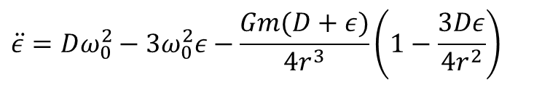
T1 IPhO 2011
1.3
$$\ddot{ε}=Dω_{0}^{2}−3ω_{0}^{2}ε−\frac{Gm(D+ε)}{4r^{3}}\left(1−\frac{3Dε}{4r^{2}}\right)$$

Slide 72
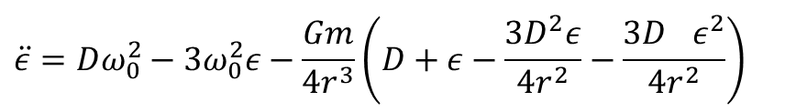
T1 IPhO 2011
1.3
$$\ddot{ε}=Dω_{0}^{2}−3ω_{0}^{2}ε−\frac{Gm(D+ε)}{4r^{3}}\left(1−\frac{3Dε}{4r^{2}}\right)$$
$$\ddot{ε}=Dω_{0}^{2}−3ω_{0}^{2}ε−\frac{Gm}{4r^{3}}\left(D+ε−\frac{3D^{2}ε}{4r^{2}}−\frac{3D^{}ε^{2}}{4r^{2}}\right)$$

Slide 73
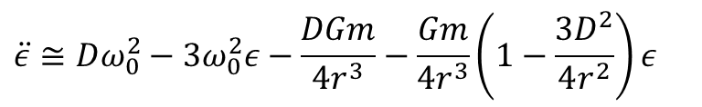
T1 IPhO 2011
1.3
$$\ddot{ε}=Dω_{0}^{2}−3ω_{0}^{2}ε−\frac{Gm(D+ε)}{4r^{3}}\left(1−\frac{3Dε}{4r^{2}}\right)$$
$$\ddot{ε}=Dω_{0}^{2}−3ω_{0}^{2}ε−\frac{Gm}{4r^{3}}\left(D+ε−\frac{3D^{2}ε}{4r^{2}}−\frac{3D^{}ε^{2}}{4r^{2}}\right)$$
$$\ddot{ε}≅Dω_{0}^{2}−3ω_{0}^{2}ε−\frac{DGm}{4r^{3}}−\frac{Gm}{4r^{3}}\left(1−\frac{3D^{2}}{4r^{2}}\right)ε$$

Slide 74
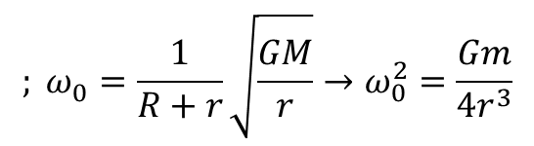
T1 IPhO 2011
1.3
$$\ddot{ε}=Dω_{0}^{2}−3ω_{0}^{2}ε−\frac{Gm(D+ε)}{4r^{3}}\left(1−\frac{3Dε}{4r^{2}}\right)$$
$$\ddot{ε}=Dω_{0}^{2}−3ω_{0}^{2}ε−\frac{Gm}{4r^{3}}\left(D+ε−\frac{3D^{2}ε}{4r^{2}}−\frac{3D^{}ε^{2}}{4r^{2}}\right)$$
$$; ω_{0}^{}=\frac{1}{R+r}\sqrt{\frac{GM}{r}}→ω_{0}^{2}=\frac{Gm}{4r^{3}}$$
$$\ddot{ε}≅Dω_{0}^{2}−3ω_{0}^{2}ε−\frac{DGm}{4r^{3}}−\frac{Gm}{4r^{3}}\left(1−\frac{3D^{2}}{4r^{2}}\right)ε$$

Slide 75
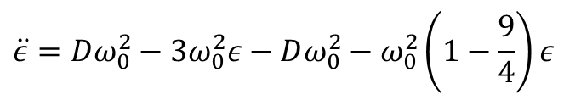
T1 IPhO 2011
1.3
$$\ddot{ε}=Dω_{0}^{2}−3ω_{0}^{2}ε−\frac{Gm(D+ε)}{4r^{3}}\left(1−\frac{3Dε}{4r^{2}}\right)$$
$$\ddot{ε}=Dω_{0}^{2}−3ω_{0}^{2}ε−\frac{Gm}{4r^{3}}\left(D+ε−\frac{3D^{2}ε}{4r^{2}}−\frac{3D^{}ε^{2}}{4r^{2}}\right)$$
$$; ω_{0}^{}=\frac{1}{R+r}\sqrt{\frac{GM}{r}}→ω_{0}^{2}=\frac{Gm}{4r^{3}}$$
$$\ddot{ε}≅Dω_{0}^{2}−3ω_{0}^{2}ε−\frac{DGm}{4r^{3}}−\frac{Gm}{4r^{3}}\left(1−\frac{3D^{2}}{4r^{2}}\right)ε$$
$$\ddot{ε}=Dω_{0}^{2}−3ω_{0}^{2}ε−Dω_{0}^{2}−ω_{0}^{2}\left(1−\frac{9}{4}\right)ε$$

Slide 76
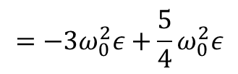
T1 IPhO 2011
1.3
$$\ddot{ε}=Dω_{0}^{2}−3ω_{0}^{2}ε−\frac{Gm(D+ε)}{4r^{3}}\left(1−\frac{3Dε}{4r^{2}}\right)$$
$$\ddot{ε}=Dω_{0}^{2}−3ω_{0}^{2}ε−\frac{Gm}{4r^{3}}\left(D+ε−\frac{3D^{2}ε}{4r^{2}}−\frac{3D^{}ε^{2}}{4r^{2}}\right)$$
$$; ω_{0}^{}=\frac{1}{R+r}\sqrt{\frac{GM}{r}}→ω_{0}^{2}=\frac{Gm}{4r^{3}}$$
$$\ddot{ε}≅Dω_{0}^{2}−3ω_{0}^{2}ε−\frac{DGm}{4r^{3}}−\frac{Gm}{4r^{3}}\left(1−\frac{3D^{2}}{4r^{2}}\right)ε$$
$$\ddot{ε}=Dω_{0}^{2}−3ω_{0}^{2}ε−Dω_{0}^{2}−ω_{0}^{2}\left(1−\frac{9}{4}\right)ε$$
$$=−3ω_{0}^{2}ε+\frac{5}{4}ω_{0}^{2}ε$$

Slide 77
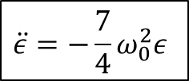
T1 IPhO 2011
1.3
$$\ddot{ε}=Dω_{0}^{2}−3ω_{0}^{2}ε−\frac{Gm(D+ε)}{4r^{3}}\left(1−\frac{3Dε}{4r^{2}}\right)$$
$$\ddot{ε}=Dω_{0}^{2}−3ω_{0}^{2}ε−\frac{Gm}{4r^{3}}\left(D+ε−\frac{3D^{2}ε}{4r^{2}}−\frac{3D^{}ε^{2}}{4r^{2}}\right)$$
$$; ω_{0}^{}=\frac{1}{R+r}\sqrt{\frac{GM}{r}}→ω_{0}^{2}=\frac{Gm}{4r^{3}}$$
$$\ddot{ε}≅Dω_{0}^{2}−3ω_{0}^{2}ε−\frac{DGm}{4r^{3}}−\frac{Gm}{4r^{3}}\left(1−\frac{3D^{2}}{4r^{2}}\right)ε$$
$$\ddot{ε}=Dω_{0}^{2}−3ω_{0}^{2}ε−Dω_{0}^{2}−ω_{0}^{2}\left(1−\frac{9}{4}\right)ε$$
$$=−3ω_{0}^{2}ε+\frac{5}{4}ω_{0}^{2}ε$$
$$\ddot{ε}=−\frac{7}{4}ω_{0}^{2}ε$$

Slide 78

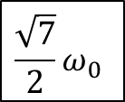
T1 IPhO 2011
1.3
$$\ddot{ε}=Dω_{0}^{2}−3ω_{0}^{2}ε−\frac{Gm(D+ε)}{4r^{3}}\left(1−\frac{3Dε}{4r^{2}}\right)$$
$$\ddot{ε}=Dω_{0}^{2}−3ω_{0}^{2}ε−\frac{Gm}{4r^{3}}\left(D+ε−\frac{3D^{2}ε}{4r^{2}}−\frac{3D^{}ε^{2}}{4r^{2}}\right)$$
$$; ω_{0}^{}=\frac{1}{R+r}\sqrt{\frac{GM}{r}}→ω_{0}^{2}=\frac{Gm}{4r^{3}}$$
$$\ddot{ε}≅Dω_{0}^{2}−3ω_{0}^{2}ε−\frac{DGm}{4r^{3}}−\frac{Gm}{4r^{3}}\left(1−\frac{3D^{2}}{4r^{2}}\right)ε$$
$$\ddot{ε}=Dω_{0}^{2}−3ω_{0}^{2}ε−Dω_{0}^{2}−ω_{0}^{2}\left(1−\frac{9}{4}\right)ε$$
$$=−3ω_{0}^{2}ε+\frac{5}{4}ω_{0}^{2}ε$$
$$\ddot{ε}=−\frac{7}{4}ω_{0}^{2}ε$$
$$\frac{\sqrt{7}}{2}ω_{0}$$
$$→$$
Frequência angular:

Slide 79
T1 IPhO 2011
1.4

Slide 80
T1 IPhO 2011
1.4
Referencial do Centro de Massa:

Slide 81
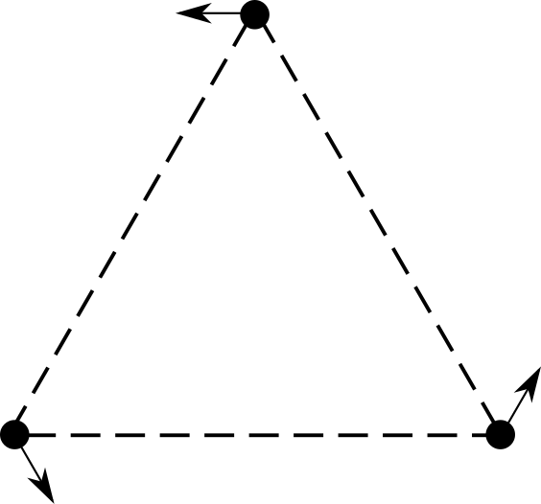
T1 IPhO 2011
1.4
Referencial do Centro de Massa:

Slide 82
T1 IPhO 2011
1.4
Referencial de uma das massas:

Slide 83
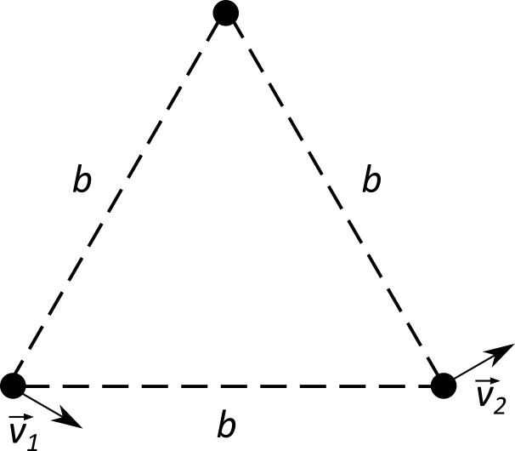
T1 IPhO 2011
1.4
Referencial de uma das massas:

Slide 84

T1 IPhO 2011
1.4
Referencial de uma das massas:
$$\left|\vec{v_{1}}\right|=\left|\vec{v_{2}}\right|=v$$

Slide 85
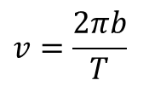
T1 IPhO 2011
1.4
Referencial de uma das massas:
$$\left|\vec{v_{1}}\right|=\left|\vec{v_{2}}\right|=v$$
$$v=\frac{2πb}{T}$$

Slide 86
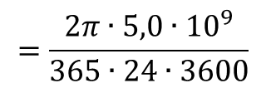
T1 IPhO 2011
1.4
Referencial de uma das massas:
$$\left|\vec{v_{1}}\right|=\left|\vec{v_{2}}\right|=v$$
$$v=\frac{2πb}{T}$$
$$=\frac{2π∙5,0∙{10}^{9}}{365∙24∙3600}$$

Slide 87


T1 IPhO 2011
1.4
Referencial de uma das massas:
$$\left|\vec{v_{1}}\right|=\left|\vec{v_{2}}\right|=v$$
$$v=\frac{2πb}{T}$$
$$=\frac{2π∙5,0∙{10}^{9}}{365∙24∙3600}$$
$$→$$
$$v=1,0 km/s$$

